Slide 1
Foundations of Integrated Assessment Modeling A brief history with examples

Slide 2
Foundations of Integrated Assessment
Today’s Topics
Some background
Integrated assessment modeling (IAM) history
Highly detailed IAMs
Scenarios

Slide 3
Climate basics

Slide 4
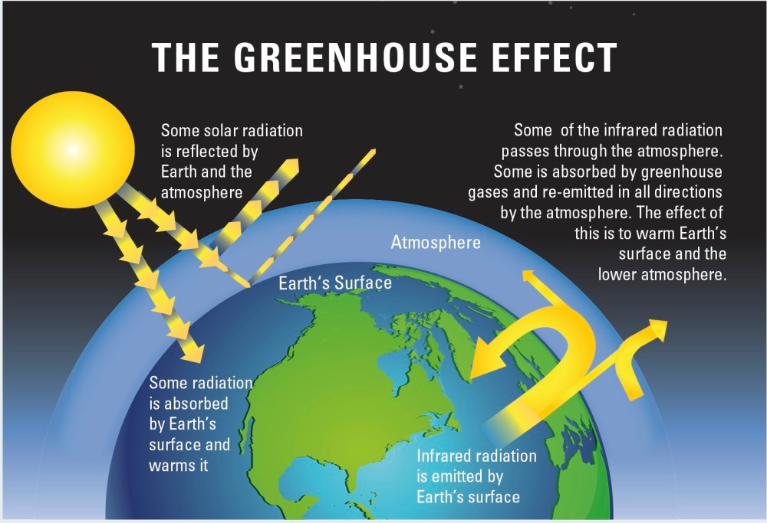
Climate Change
Average Earth temperature ~15ºC (59ºF)
Earth’s black body temperature -23°C (-9.4ºF)
Gases that change climate forcing include H₂O, CO₂, CH₄, N₂O, halons, short-lived forcers, and aerosols.
CO₂ is the most important human-generated GHG emitted
https://royalsociety.org/-/media/Royal_Society_Content/policy/projects/climate-evidence-causes/figb1-large.jpg?la=en-GB&hash=596B576CF5ADAF30D03D1AEFECF26997

Slide 5
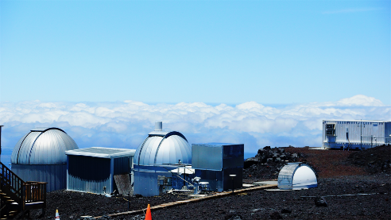
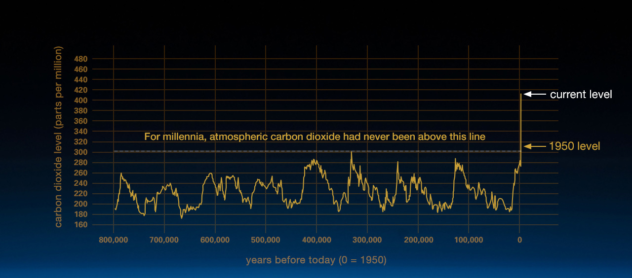
CO₂ the last 800,000 years
CO₂ Jan 30 2023 419.7 PPM at NOAA’s Mauna Loa Atmospheric Baseline Observatory
Vostok ice core data/J.R. Petit et al.; NOAA Mauna Loa CO₂ record.
Preindustrial ~280 ppm
Source: https://climate.nasa.gov/news/2535/satellite-data-confirm-annual-carbon-dioxide-minimum-above-400-ppm/

Slide 6
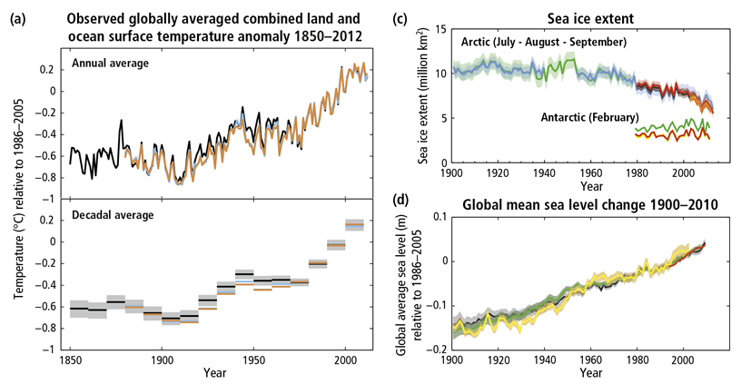
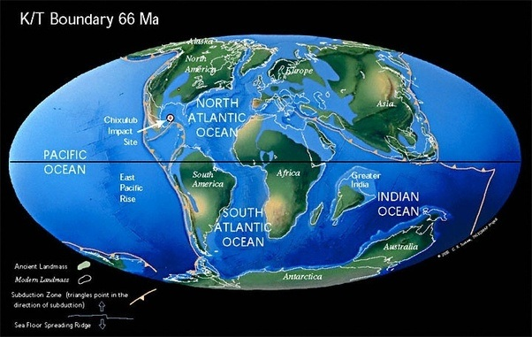
ΔT ~1.0ºC (1.8ºF) Warming since 1850
Sea level rise 20cm (7.9in)
Arctic sea ice reduction
Sea levels were much higher when CO₂ concentrations where much higher and the Earth much warmer than today
https://www.ipcc.ch/site/assets/uploads/2018/02/Fig-1.01-01-2.png
Source: https://qph.fs.quoracdn.net/main-qimg-a6fe08a52dd7b90cf59658764e295cd2-c

Slide 7
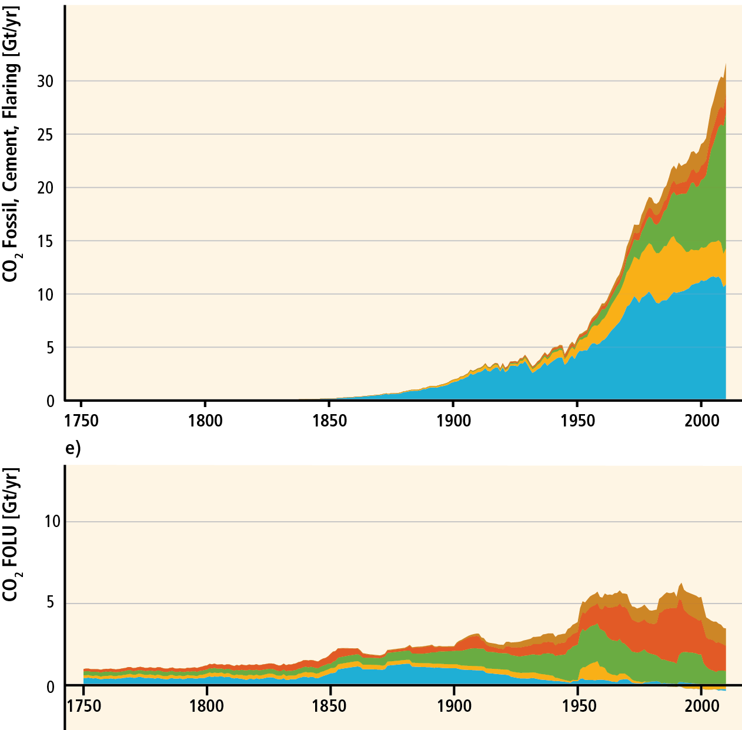
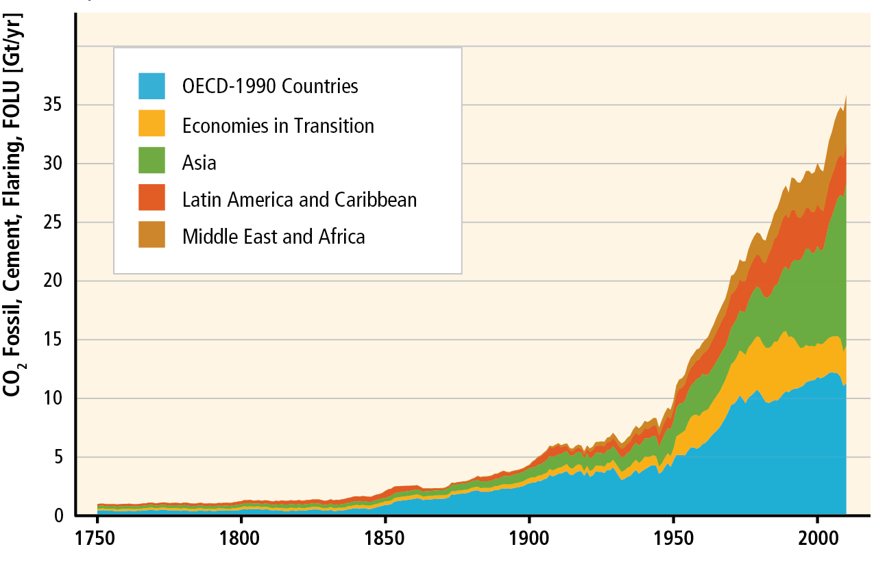
Fossil fuel and Land-use change emissions
Source: https://www.ipcc.ch/report/graphics/index.php?t=Assessment%20Reports&r=AR5%20-%20WG3&f=Technical%20Summary

Slide 8
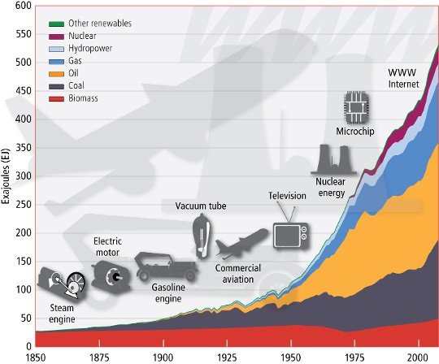
Source: http://www.iiasa.ac.at/web/home/resources/publications/options/Sustainable.en.html

Slide 9
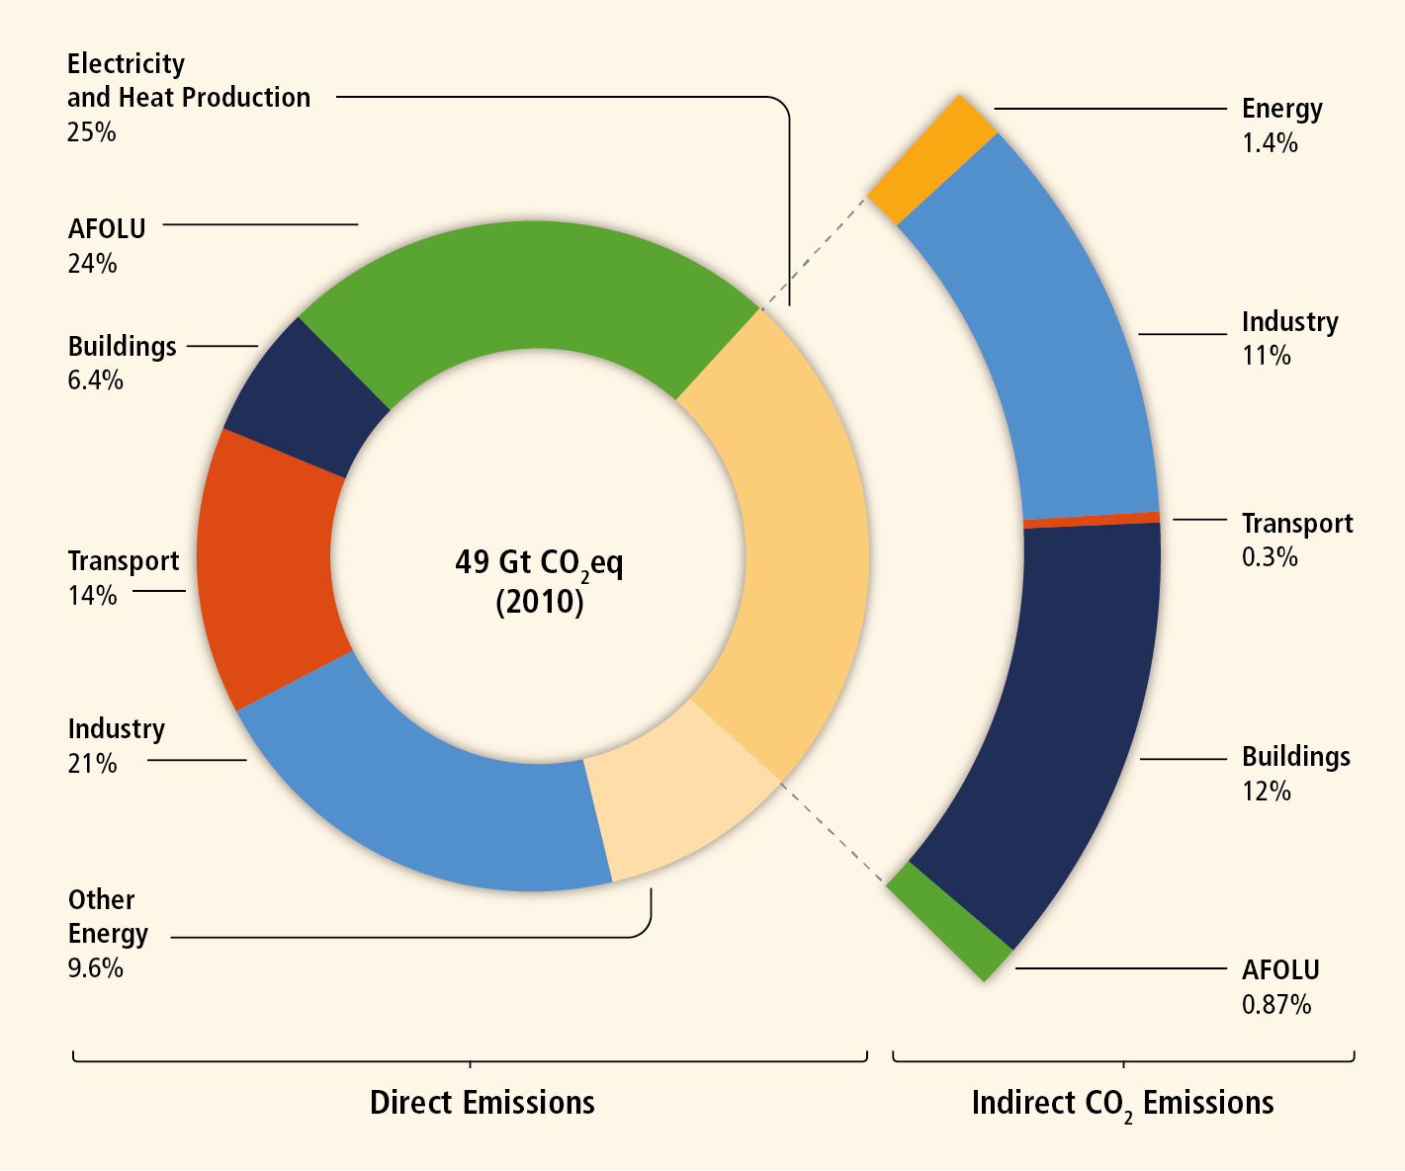
Greenhouse gas emissions by economic sector
Source: https://www.ipcc.ch/report/graphics/index.php?t=Assessment%20Reports&r=AR5%20-%20WG3&f=Technical%20Summary

Slide 10
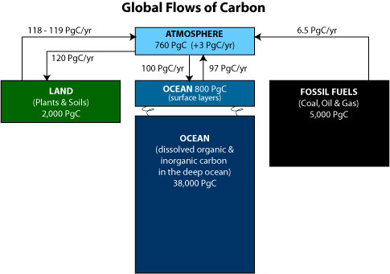
Carbon Reservoirs
Source: https://science.nasa.gov/earth-science/oceanography/ocean-earth-system/ocean-carbon-cycle

Slide 11

Fossil Fuel Reserves versus Resources
Source: https://science.nasa.gov/earth-science/oceanography/ocean-earth-system/ocean-carbon-cycle
Source: https://www.nationalobserver.com/2015/05/14/news/climate-number-changes-everything

Slide 12
A brief comment of greenhouse gases
Comparing greenhouse gas emissions is REALLY difficult.
CO₂ and the other gases behave differently
Greenhouse gases fall into three categories
Short-lived species, with atmospheric sinks, e.g. CO, NO_{x}, CH₄, and N₂O.
For these gases constant emissions means constant concentration.
C = λE, where λ is the inverse of the annual rate of atmospheric removal.
Very long lived species for which removal atmospheric rates are near zero, e.g. CFCs, and other manufactured gases.
For these gases concentrations rise linearly with emissions.
And then there’s CO₂.

Slide 13
The Carbon Cycle
Cumulative emissions of CO₂ determine steady-state CO₂ concentrations.
Start with the Atmosphere and Ocean in Equilibrium.
CO₂ Emissions
Add CO₂ to the Atmosphere
Ocean
Atmosphere
CO₂ is transferred from the Atmosphere to the Ocean until an equilibrium is restored.

Slide 14
The Carbon Cycle
In the long-run CO₂ emissions must approach zero.
CO₂ Emissions
And, the carbon accumulating in the ocean causes ocean acidification.
Ocean
Atmosphere

Slide 15
Climate Sensitivity and Average Earth Surface Temperature Change
Climate Sensitivity is the change in the EQUILIBRIUM Earth surface temperature change following a doubling in the concentration of CO₂ or an equivalent change in another atmospheric constituent
Median Climate Sensitivity = 3ºC
Range is 1.5ºC to 4.5ºC (the same as it was 40 years ago in 1983)

Slide 16
Integrated assessment modeling

Slide 17
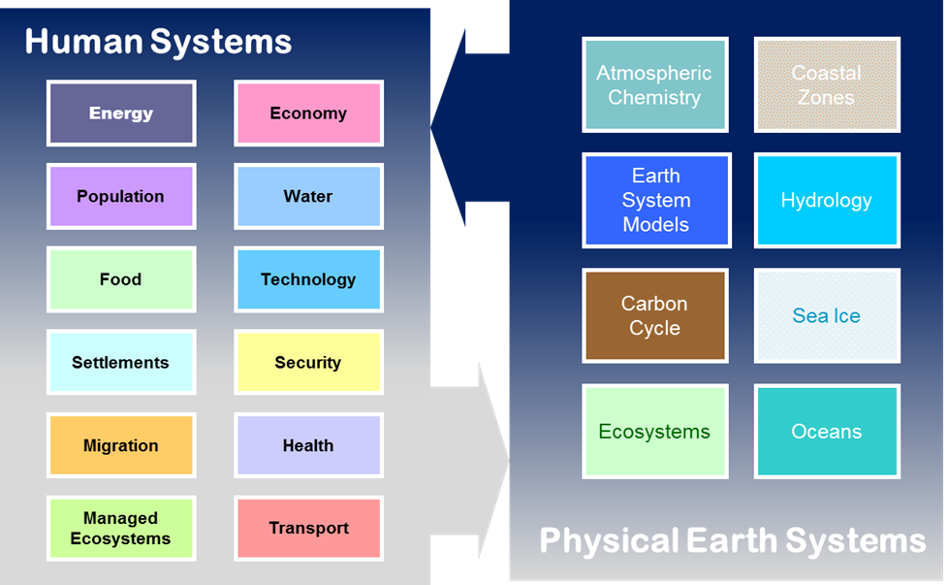
Integrated Assessment Models
IAMs integrate human and natural Earth system climate science.
IAMs provide insights that would be otherwise unavailable from disciplinary research alone.
IAMs capture interactions between complex and highly nonlinear systems.
IAMs provide natural science researchers with information about human systems such as GHG emissions, land use and land cover.
IAMs provide important, science-based decision support tools.
IAMs support national, international, regional, and private-sector decisions.

Slide 18




Integrated Assessment Models (IAMs) have external inputs and data, a representation of relevant systems and outputs
The Model
Exogenous Assumptions
Outputs of IAMs
Population
Economy
Agriculture & Land Use
Climate, Atmosphere, Oceans
CO₂, GHGs, aerosols, OGs
Prices, Taxes, e.g. CO₂
Labor Productivity
Commodity Prices
Technology
Economic Activity
Primary Energy Supply
Policy
Energy
Water
Carbon Cycle
Electric & Refining
Crops & Forests
Resources
Livestock
Temperature, RF
Highly non-linear, strategic models designed to consider global climate forcing and climate impacts at decadal time scales and regional disaggregation ranging from dozens to hundreds
External Data

Slide 19
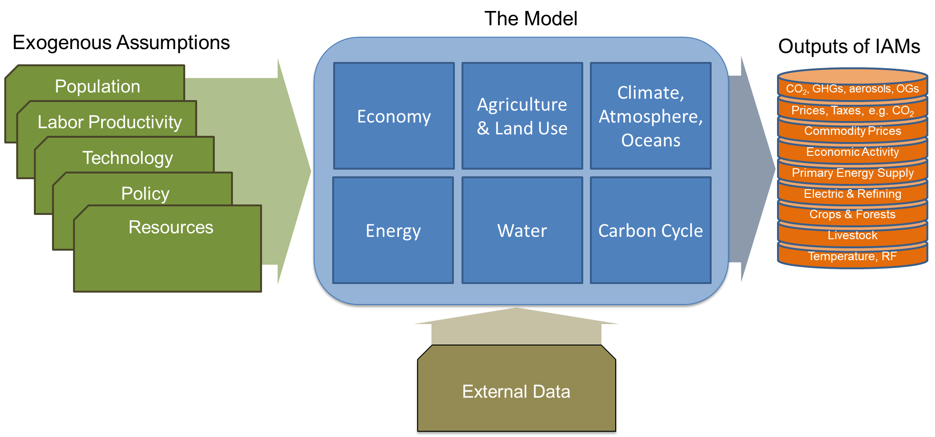
Models and Scenarios
Models are structured relationships that produce conditional forecasts.
Scenarios are conditional forecasts.
if
then

Slide 20
Optimization Models
Optimization IAMs
MESSAGE (IIASA)
ReMIND (PIK)
Some IAMs use an optimization structure. Doesn’t that mean they are NOT responsible for producing conditional forecasts.
if
then

Slide 21
Two Major Types of IAMS
Integrated assessment models divide into two major branches:
Highly Aggregated Models, where the central problem is determining the social cost of carbon, and
1970’s all IAMs were highly aggregated
Today RICE, DICE, PAGE, and other IAMs remain highly aggregated

Slide 22
To Major Types of IAMS
Today GCAM, IMAGE, MESSAGE, REMIND, AIM have all developed into highly detailed models
Integrated assessment models divide into two major branches:
Highly Aggregated Models, where the central problem is determining the social cost of carbon, and
Highly Detailed Human-Earth System models, whose primary problem is describing the detailed interactions of human and physical Earth systems, in physical units
1970’s all IAMs were highly aggregated
Today RICE, DICE, PAGE, and other IAMs remain highly aggregated

Slide 23

Where did IAMs come from?
Bill Nordhaus started it all
1979 The Efficient Use of Energy Resources , Yale University Press.
In 2018, Bill won the Nobel Prize in Economics “for integrating climate change into long-run macroeconomic analysis.”
That work was followed by the DICE model, which premiered in
“Future Carbon Dioxide Emissions from Fossil Fuels,” with Gary Yohe, in National Research Council-National Academy of Sciences, Changing Climate, National Academy Press, 1983.
Dice is highly aggregated. It has 30 equations.
http://www.econ.yale.edu/~nordhaus/homepage/Web-DICE-2013-April.htm

Slide 24
The DICE: the world in 30 Equations

Slide 25
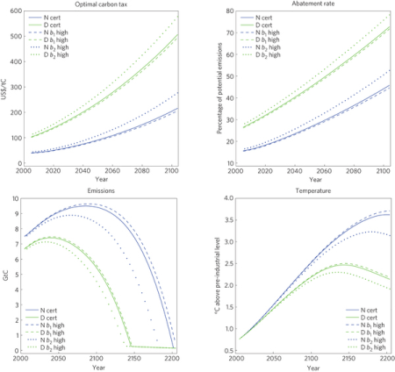
Nordhaus central problem is cost-benefit
What is the socially optimal emissions path?
What is the optimal global carbon tax?
What is the optimal change in climate?
How do you monetize climate damages, many of which do not pass through markets?
How do you discount costs and benefits?
Source: Crost, Benjamin, and Christian P. Traeger. "Optimal CO2 mitigation under damage risk valuation." Nature Climate Change (2014).

Slide 26
The most important contribution highly aggregated IAMs make is defining the Social Cost of Carbon
The social cost of carbon (SCC) is an estimate, in dollars, of the economic damages that would result from emitting one additional ton of greenhouse gases into the atmosphere.
EPA estimates: $120/tCO₂ (2.5%discount rate),
$190/tCO₂ (2.0%discount rate),
$340/tCO₂ (1.5%discount rate).
RFF estimate: $185/tCO₂ (2.0%discount rate).

Slide 27
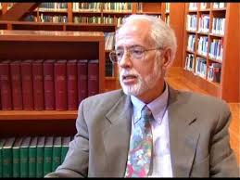
Highly aggregated IAMs have drawn the ire of critiques such as Robert Pindyck
“These models [IAMs] have crucial flaws that make them close to useless as tools for policy analysis: certain inputs (e.g., the discount rate) are arbitrary, but have huge effects on the SCC estimates the models produce; the models' descriptions of the impact of climate change are completely ad hoc, with no theoretical or empirical foundation; and the models can tell us nothing about the most important driver of the SCC, the possibility of a catastrophic climate outcome. IAM-based analyses of climate policy create a perception of knowledge and precision, but that perception is illusory and misleading.”
Pindyck, Robert S.. 2013. "Climate Change Policy: What Do the Models Tell Us?." Journal of Economic Literature, 51(3):860-72.

Slide 28

Researchers such as John Weyant have defended the field of integrated assessment
Researchers such as Weyant have pressed the case for IAMs, and particularly highly detailed IAMs as valuable research and policy support tools.
Weyant, J. “Some Contributions of Integrated Assessment Models of Global Climate Change” Review Of Environmental Economics And Policy, 2017; 11 (1): 115-137

Slide 29
Highly Detailed IAMS

Slide 30
GCAM has its roots in the same time frame
The Global Change Assessment Model (GCAM) began in 1978.
Jae Edmonds and John Reilly
Reilly was the director of the MIT IAM program until he retired in 2020.
The original science question was would fossil fuel CO2 emissions continue to rise at 4.5%/yr? (which implied that CO2 concentrations would double around the year 2000)

Slide 31



Highly detailed IAMs are developed by interdisciplinary teams
Model | Home Institution
AIM Asia Integrated Model | National Institutes for Environmental Studies, Tsukuba Japan
GCAM Global Change Assessment Model | Joint Global Change Research Institute, PNNL, College Park, MD
IGSM Integrated Global System Model | Joint Program, MIT, Cambridge, MA
IMAGE The Integrated Model to Assess the Global Environment | PBL Netherlands Environmental Assessment Agency, Bildhoven, The Netherlands
MESSAGE Model for Energy Supply Strategy Alternatives and their General Environmental Impact | International Institute for Applied Systems Analysis; Laxenburg, Austria
REMIND Regionalized Model of Investments and Technological Development | Potsdam Institute for Climate Impacts Research; Potsdam, Germany
More are on the way

Slide 32
Fully developed IAMs include all of
The Model
Exogenous Assumptions
Outputs of IAMs
Population
Economy
Agriculture & Land Use
Climate, Atmosphere, Oceans
CO₂, GHGs, aerosols, OGs
Prices, Taxes, e.g. CO₂
Labor Productivity
Commodity Prices
Technology
Economic Activity
Primary Energy Supply
Policy
Energy
Water
Carbon Cycle
Electric & Refining
Crops & Forests
Resources
Livestock
Temperature, RF
Highly non-linear, strategic models designed to consider global climate forcing and climate impacts at decadal time scales and regional disaggregation ranging from dozens to hundreds
External Data

Slide 33

Scenarios are Produced by Models
Models vary in complexity and detail
You don’t need a full integrated assessment model (IAM) to be in the modeling business

Slide 34
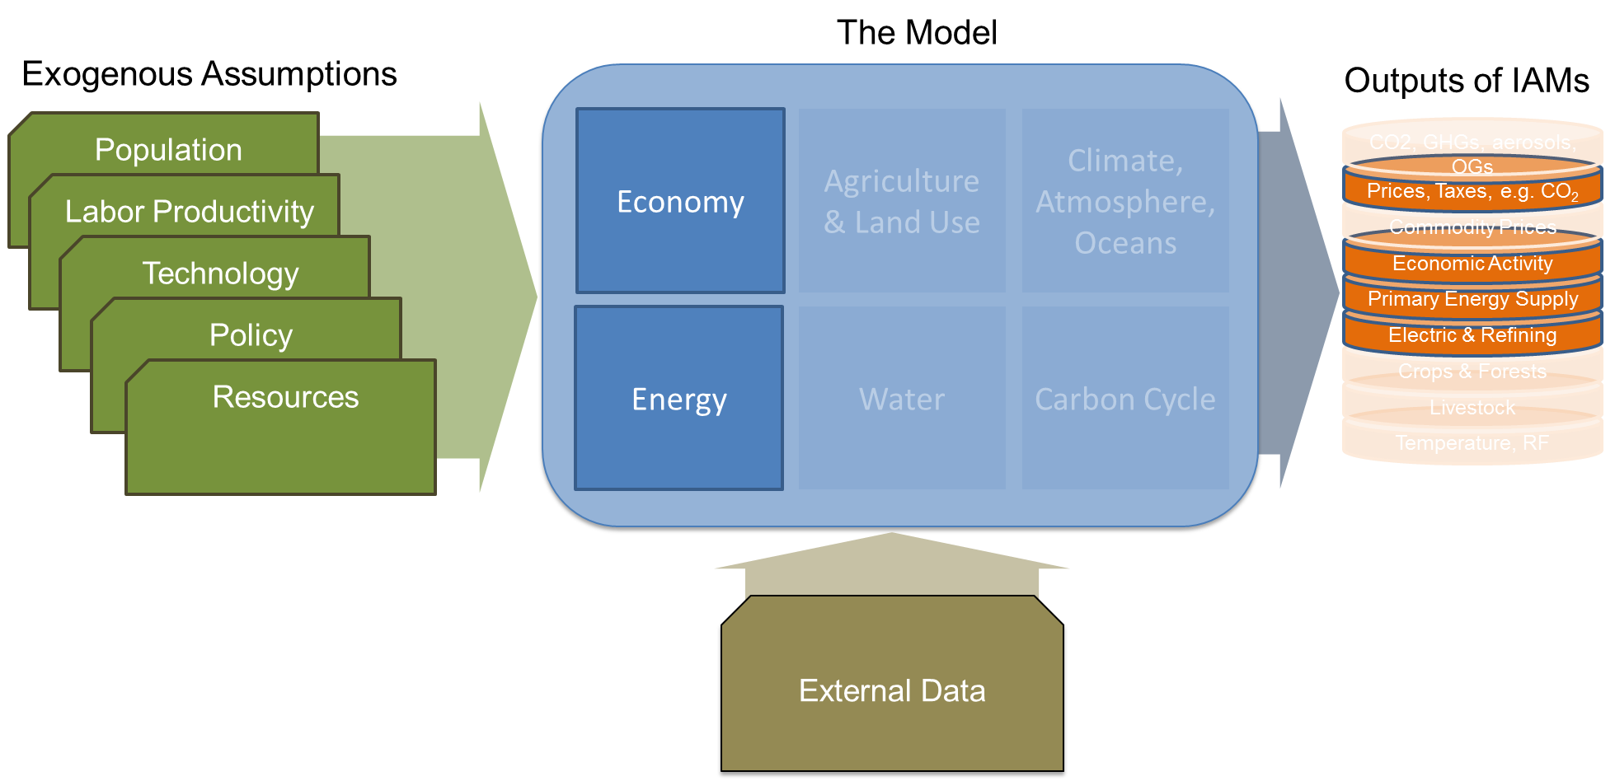
Energy models assume non-energy emissions and cumulative emissions budget
The cumulative emissions (from pre-industrial) budget approximation
2ºC ΔT = 1000 billion tons C-e
2ºC ΔT = 3667 billion tons CO₂-e
Cumulative C to 2013
= 730 billion tons C
= 2677 billion tons CO₂

Slide 35
Scenarios

Slide 36
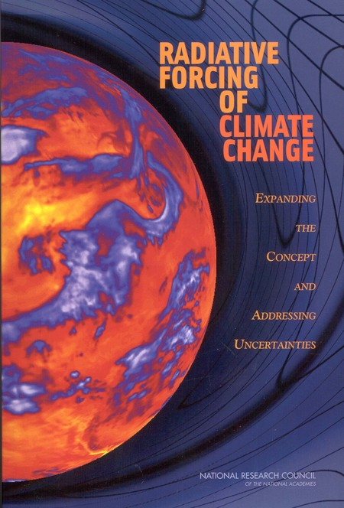
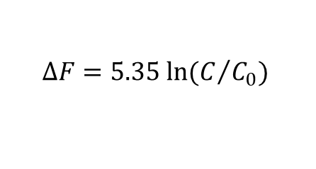
Concentrations to radiative forcing
RF is the net change in the energy balance of the Earth system due to some imposed perturbation. It is usually expressed in watts per square meter averaged over a particular period of time and quantifies the energy imbalance that occurs when the imposed change takes place.
Forcing is often presented as the value due to changes between two particular times, such as pre-industrial to present-day, while its time evolution provides a more complete picture.
Climate forcing from CO₂ Concentrations
$$∆F=5.35 ln⁡(C/{C_{0}})$$

Slide 37
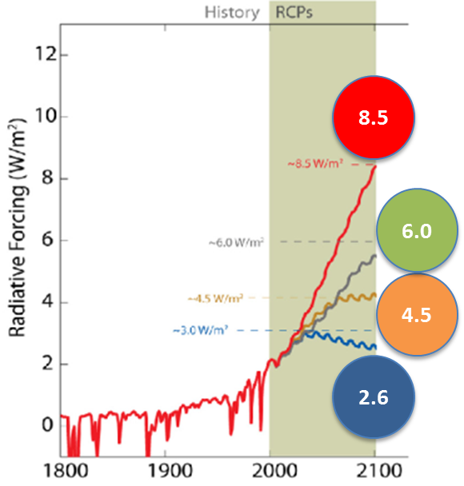
The RCPs and Climate
Scenarios are internally consistent representations of potential future developments.
RCPs are defined in terms of “Radiative Forcing”
Units=Watts/Meter^2
Best thought of as an index
0=preindustrial
RCP 8.5 = Highest scenario in the literature and keeps rising
RCP 6.0 = stabilize climate forcing
RCP 4.5 = stabilize climate forcing
RCP 2.6 = reduce climate forcing (2 degree scenario)

Slide 38

The RCPs and Climate
Each RCP was developed by a different model in a coordinated process. (Model/Institution)
MESSAGE/IIASA
Created by the Integrated Assessment Modeling Consortium (IAMC)
For the intergovernmental Panel on climate change
AIM/NIES
GCAM/PNNL
IMAGE/PBL

Slide 39
Some handy equivalents
CO2-equivalent (ppm) | Radiative Forcing (W/m²) | Avg. Global Temp. Change Long-term (ΔT)*
1360 | 8.5 (RCP) | 6.8 ºC
1030 | 7.0 | 5.6 ºC
850 | 6.0 (RCP) | 4.8 ºC
650 | 4.5 (RCP) | 3.6 ºC
550 | 3.7 | 2.9 ºC
450 | 2.6 (RCP) | 2.1 ºC
400 | 1.9 | 1.5 ºC
CO₂ is measured in both tons of CO₂ and tons of C
3.667 ton CO₂ = 1 tons C
$1/tCO₂ = $3.67/tC
CO₂ Dec 2020 414.2 PPM at NOAA’s Mauna Loa Atmospheric Baseline Observatory
Preindustrial ~280 ppm
* Assumes a climate sensitivity of 3ºC. Climate sensitivity is the number of degrees the planet would warm in the long term if the concentration of CO₂ doubled.

Slide 40
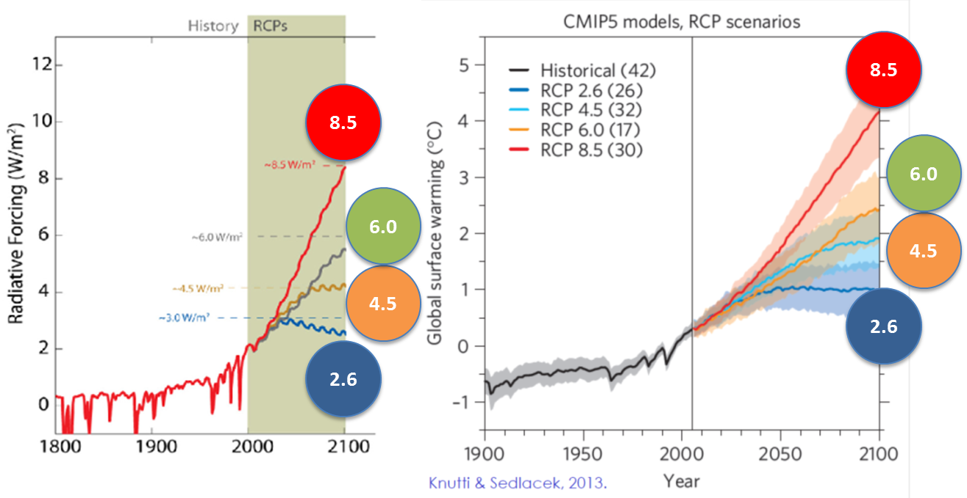
RCPs and Climate
Average Surface Long-term Temperature Change Compared to Pre-Industrial
ΔT>6.5ºC
ΔT> 4.5ºC
ΔT> 3.5ºC
ΔT~2ºC

Slide 41

RCPs and Climate
Average Surface Long-term Temperature Change Compared to Pre-Industrial
ΔT>6.5ºC
The climate simulations come from a different community—climate modelers
ΔT> 4.5ºC
ΔT> 3.5ºC
ΔT~2ºC

Slide 42
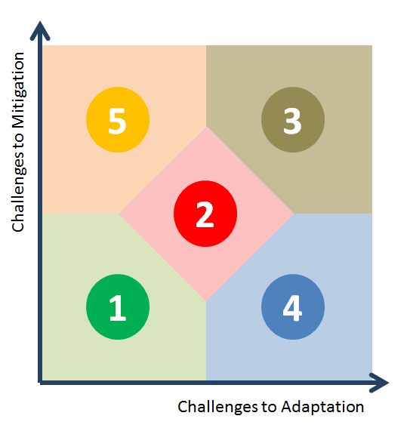

Shared Socioeconomic Pathways (SSPs)
SSPs are Reference Scenarios
No new climate policies in the future
Defined in terms of Challenges to Mitigation and Challenges to Adaptation
Brian O’Neill (JGCRI) was one of the major architects

Slide 43
Shared Socioeconomic Pathways (SSPs)
SSP5: Conventional Development
SSP3: Fragmentation
SSPs are Reference Scenarios
No new climate policies in the future
Defined in terms of Challenges to Mitigation and Challenges to Adaptation
Brian O’Neill (JGCRI) was one of the major architects
SSP2: Middle of the Road
SSP1: Sustainability
SSP4: Inequality

Slide 44
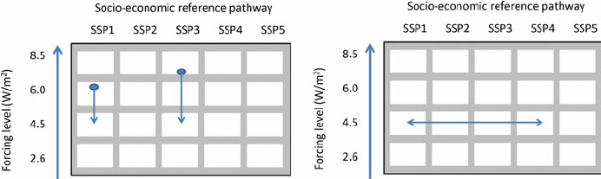
Combining SSPs with RCPs

Slide 45
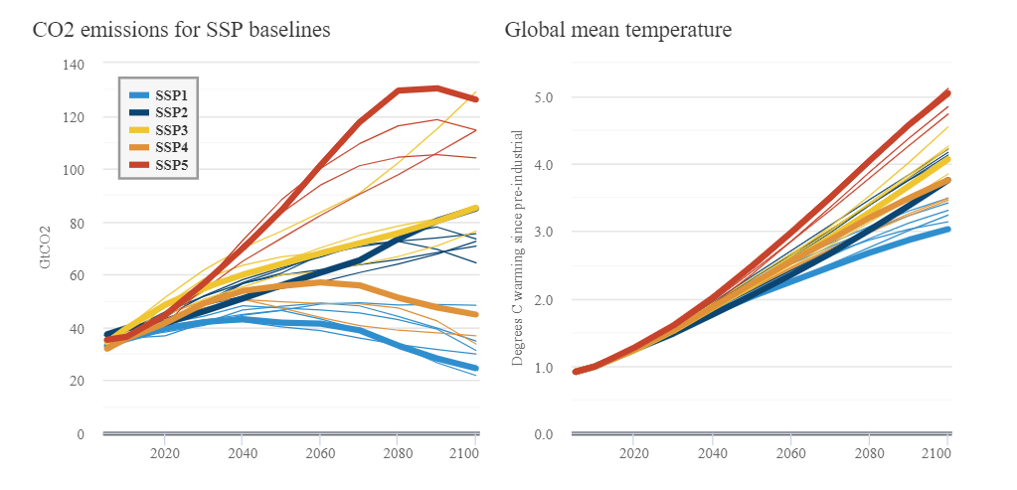
Combining SSPs Emissions and Climate

Slide 46
Combining SSPs Emissions and Climate

Slide 47
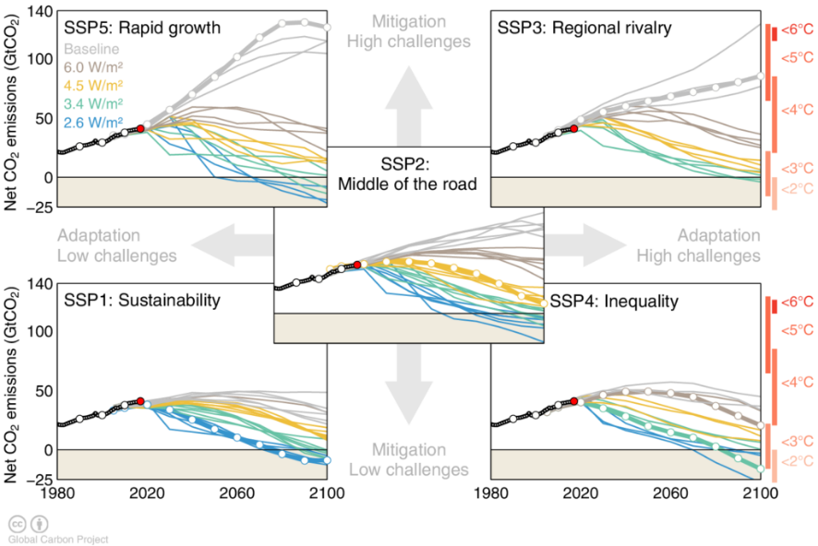
Limiting climate change to RCP levels in 5 SSP worlds

Slide 48
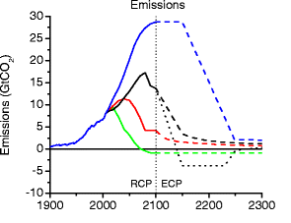
All CO2 EMISSIONS scenarios are alike—They all end at zero
CO₂ has no atmospheric sink—it doesn’t disappear
Carbon that was removed from the atmosphere over millions of years, can only be partitioned between atmosphere, ocean and land
Atmosphere (~20% on average will remain permanently)
Oceans (~80% on average will end up in oceans)

Slide 49

Getting to Zero—Five strategy elements
Energy efficiency—reduce demand for energy as much as economical
Decarbonize power generation
Fossil fuel with CCS
Renewable power
Nuclear power
Bioenergy
Bioenergy with CCS
Electrify Buildings and Industry
as much as economical
Decarbonize transport
Electrify
Biofuels
H2
Halt deforestation/afforestation and continue improving crop yields
Source: http://www.energy.gov/science-innovation/energy-sources/renewable-energy/wind
Notes:
Source: https://www.iea.org/media/news/2015/news/151104_webarticle_CO2_FINAL.pdf

Slide 50
Discussion questions
What do you think are the major science or policy contributions IAMs have made?
What are some examples of ways in which IAMs have evolved in the past few decades?
What do you think are the main challenges or criticisms of IAMs? Do these challenges or criticisms apply equally to different types of IAMs?

Slide 51
Discussion questions
What do you think are the major science or policy contributions IAMs have made?
What are some examples of ways in which IAMs have evolved in the past few decades?
What do you think are the main challenges or criticisms of IAMs? Do these challenges or criticisms apply equally to different types of IAMs?

Slide 52
Discussion questions
What do you think are the major science or policy contributions IAMs have made?
What are some examples of ways in which IAMs have evolved in the past few decades?
What do you think are the main challenges or criticisms of IAMs? Do these challenges or criticisms apply equally to different types of IAMs?

Slide 53

Q&A

Slide 54
A Cheat Sheet for IA

Slide 55
2005 Global Energy Use by Fuel
Oil = 168 EJ/yr
Gas = 99 EJ/yr
Coal = 121 EJ/yr
Traditional Bioenergy = 29 EJ/yr
Commercial and Industrial Bioenergy = 20 EJ/yr
Nuclear Power = 26 EJ/yr
Hydro Power = 29 EJ/yr
Wind Power = 1 EJ/yr
Solar Power = <1 EJ/yr
Geothermal Power = 1 EJ/yr

Slide 56
Carbon and Climate

Slide 57
Emissions
Year 2005 CO₂ Equivalent (CO₂-e) Concentrations (estimated)
Annual Average CO₂ equivalent (including all Kyoto Protocol Gases) = 433 ppm-e
Annual Average CO₂ equivalent (including all Kyoto Protocol Gases & CFCs) = 455 ppm-e
Annual Average CO₂ equivalent (including all Gases and Aerosols) = 382 ppm-e
Average DIRECT Carbon-Intensity of Energy Use by Fuel (estimated)
Oil = ~20 KgC/GJ
Gas = ~14 KgC/GJ
Coal = ~27 KgC/GJ
Nuclear, Solar, Wind, Geothermal and other renewable energy forms = ~0 KgC/GJ
2010 Average DIRECT Carbon-Intensity of Energy Use for Selected Countries
USA = ~16 KgC/GJ
China = ~24 KgC/GJ (Excluding traditional fuel use)
India = ~20 KgC/GJ (Excluding traditional fuel use)
Western Europe = ~15 KgC/GJ
Africa = ~15 KgC/GJ (Excluding traditional fuel use)
Carbon and CO₂
1 PgC = 1 Petagram carbon = 10¹⁵ grams C
1 PgC = 1 Gigaton C = 1 GtC
1 tonne C = 3.67 tonnes CO₂
Prices
$1/tCO₂ = $3.67/tC

